Slide 1
Superstore visulization
File created on: 03-Nov-21 4:26:45 PM

Slide 2
Question :
Find the sales for every year.
Find year for highest sales and lowest sales respectively.
show the view in bar graph.
Add label to your view.
Find the category wise sales for every year.
Which category has highest sales in the year 2020 & 2021.
Based on the analysis of the year 2020 & 2021. give some suggestions to improve Sales in the year 2022.
Display subcategory and find some insights from the view about max and min sales under every category.
Change the color of your visual.
Check the Tooltip.
In your bar graph, present subcategory under each bar of category using colour card
Note : - Use Superstore data

Slide 3
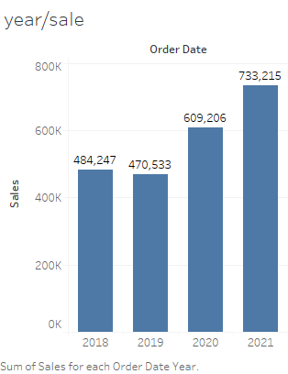
Find the sales for every year.
Find year for highest sales and lowest sales respectively.
show the view in bar graph.
Add label to your view.
Highest - 2021 year
Lowest - 2019 year

Slide 4
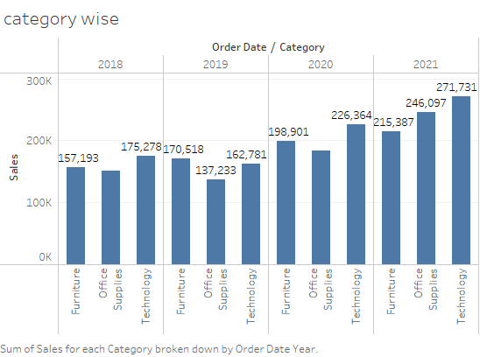
Find the category wise sales for every year.
Which category has highest sales in the year 2020 & 2021.
In 2020 and 2021 the Technology category has highest sale.

Slide 5
Based on the analysis of the year 2020 & 2021. give some suggestions to improve Sales in the year 2022.
Ans-
we see that at office and furniture categories sale very low comparision to technology then we more focus on office and furniture to more sale

Slide 6
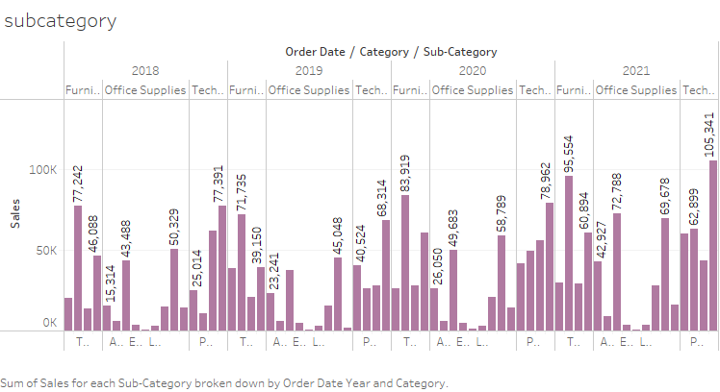
8.Display subcategory and find some insights from the view about max and min sales under every category.

